Slide 1
Scenarios and abatement options
Sources of greenhouse gas emissions
Kaya Identity
IPCC scenarios
Options for emission reduction
Population
Income
Energy
Fuel
Geoengineering

Slide 2
Lectures
Science
Scenarios & emission reduction options
Costs of emission reduction
Instruments for emission reduction
Impacts of climate change & valuation
Economic impacts of climate change
Climate and development
Adaptation policy
Optimal emission reduction
Discounting, uncertainty, equity
International environmental agreements

Slide 3
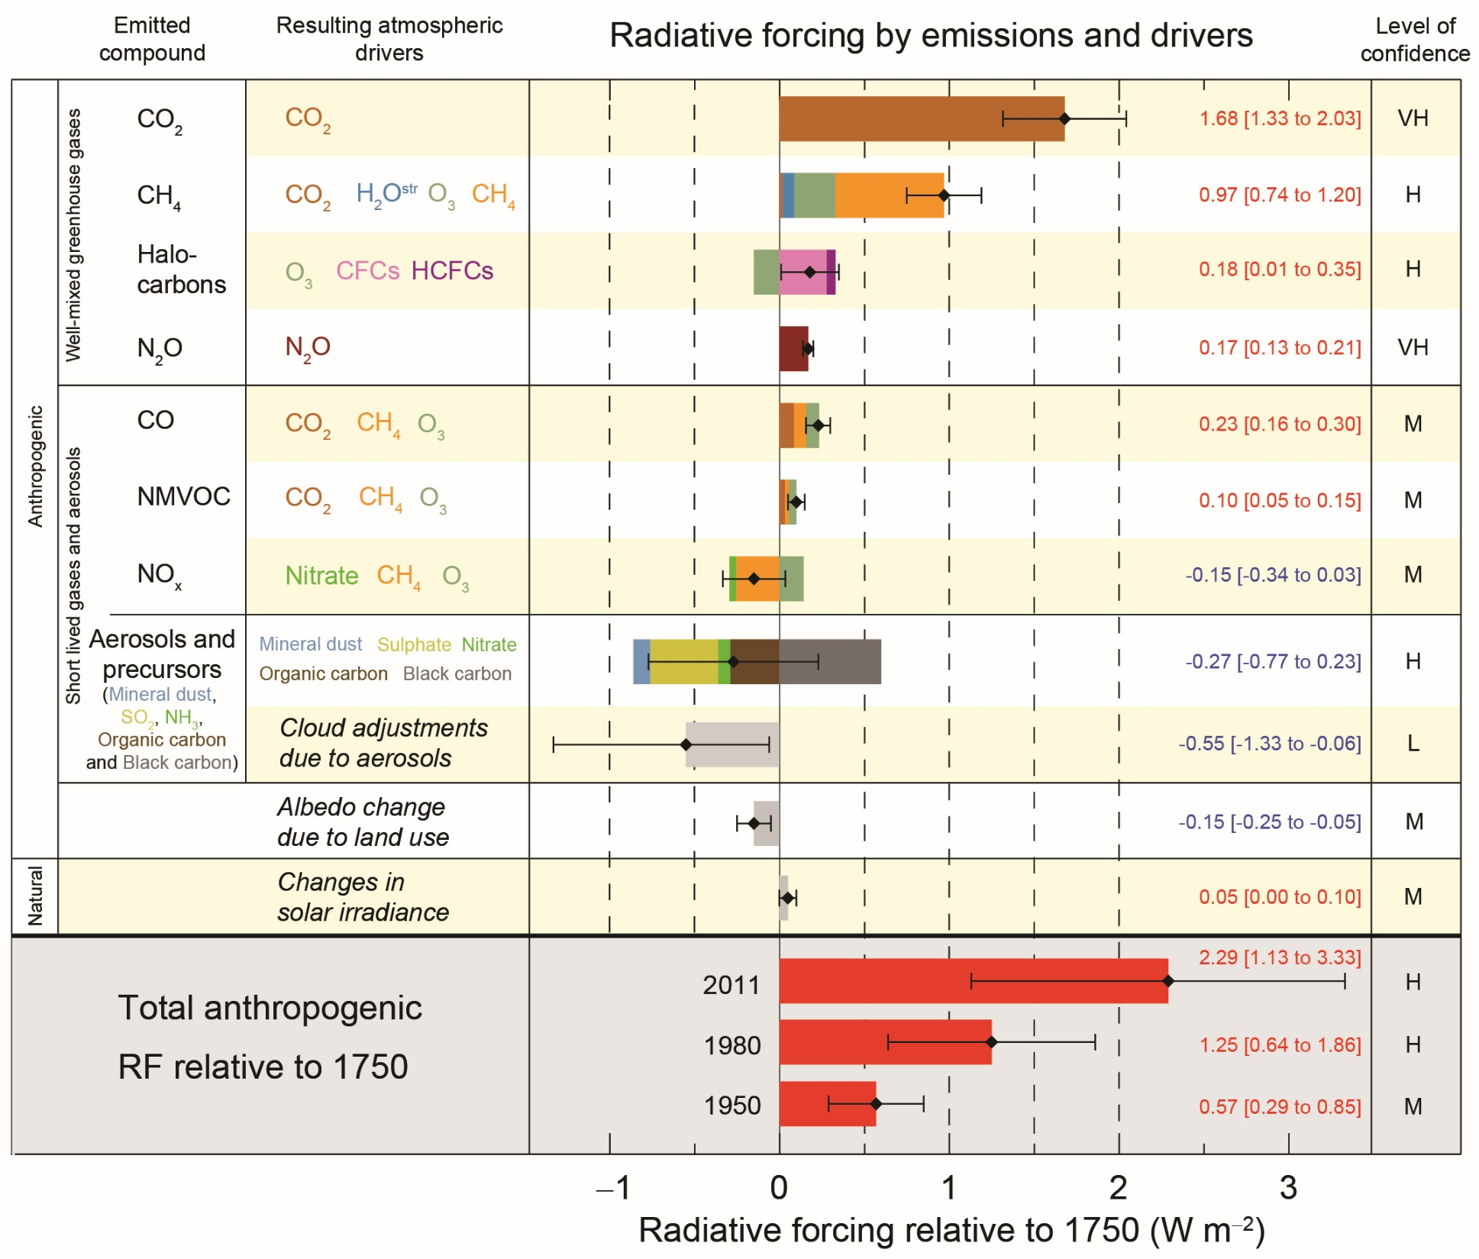

Slide 4
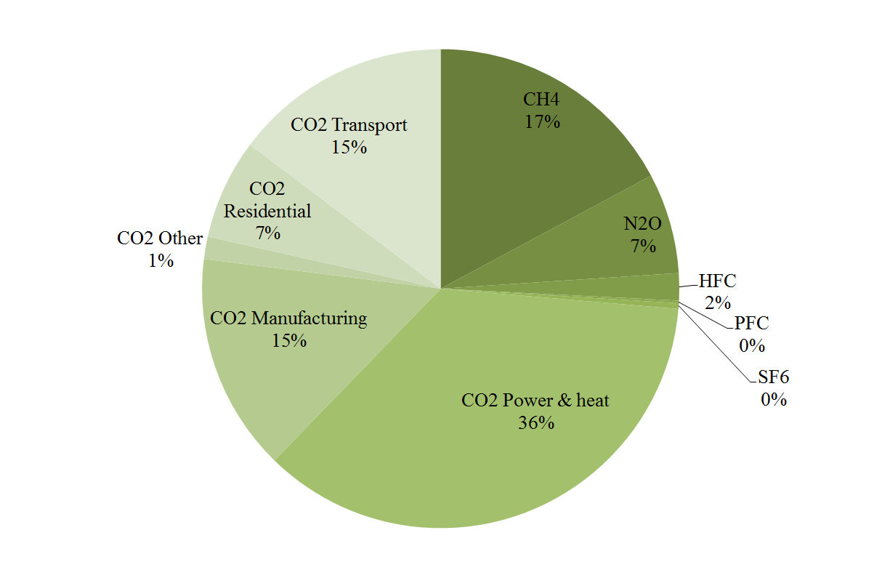

Slide 5
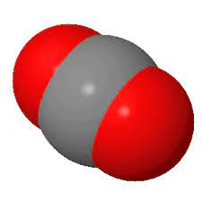
Sources of greenhouse gas emissions
Carbon dioxide
Combustion of fossil fuels
Peat 117, Coal 95, Petrol 70, Gas 57 tCO2/TJ

Slide 6
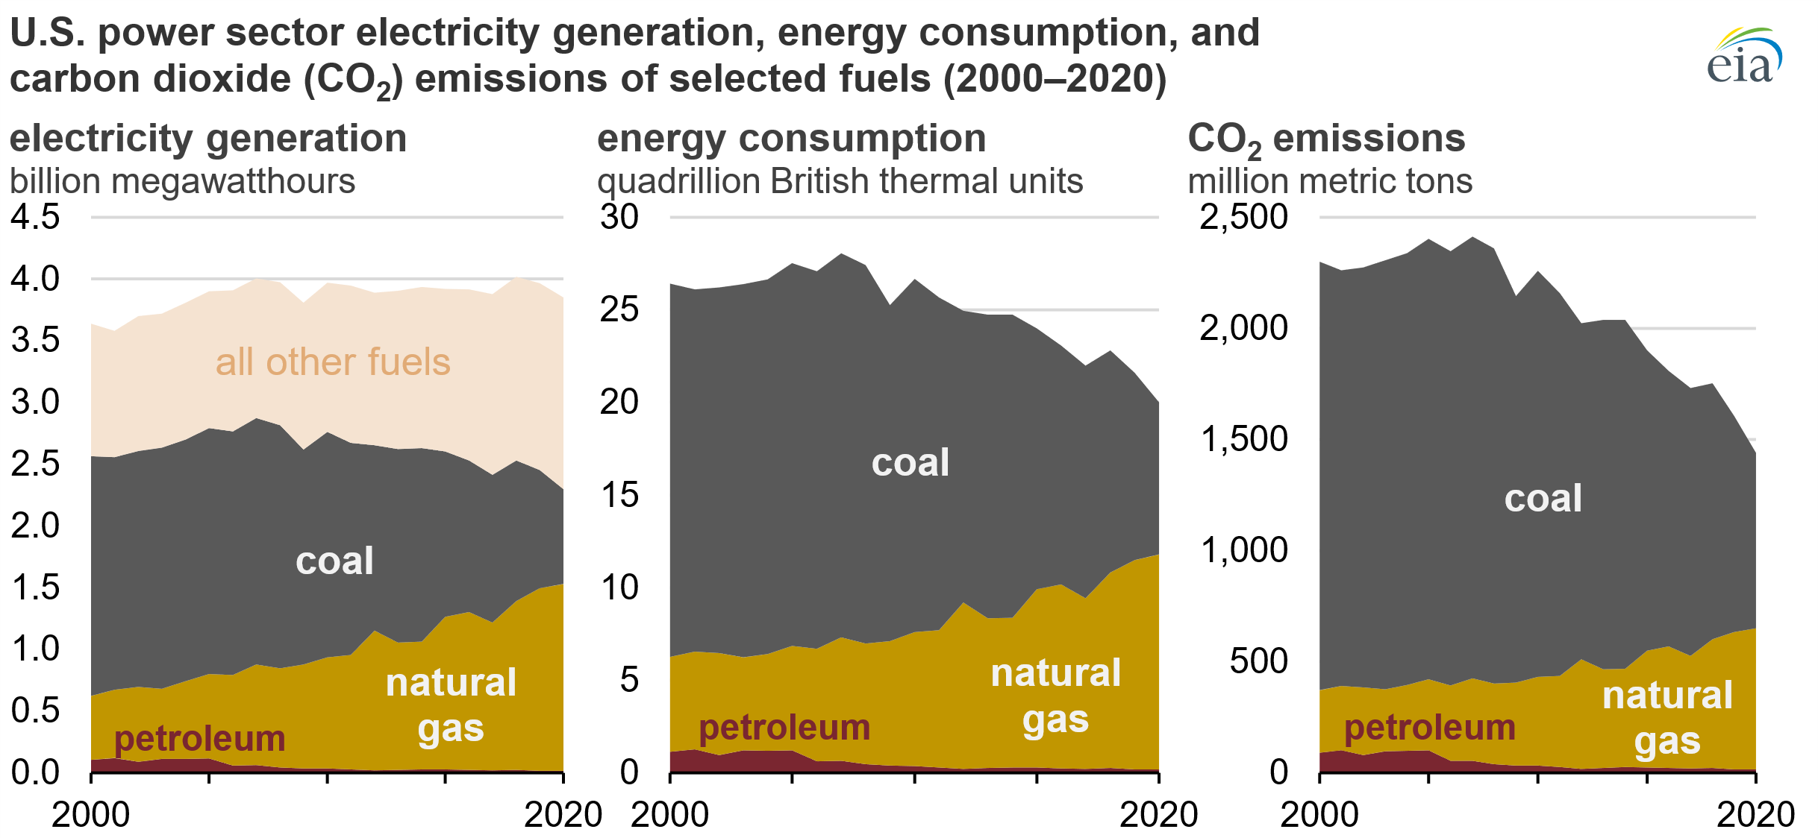

Slide 9
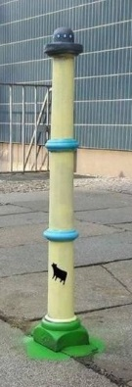
Sources of greenhouse gas emissions
Carbon dioxide
Combustion of fossil fuels
Land use change
Cement production
Methane
Ruminants
Paddy rice
Waste
Leakage
Nitrous oxide
Agriculture
Other gases
Specialised industry

Slide 10
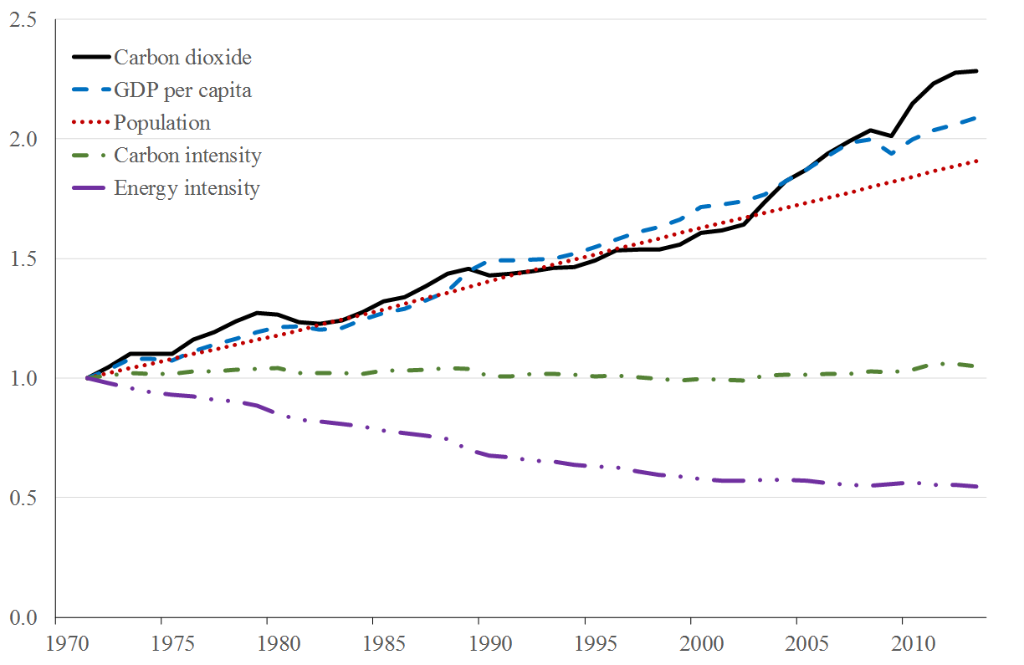
Emission trends

Slide 12
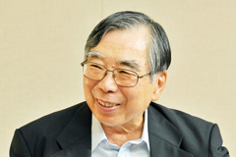

Emission scenarios
$$E=P\frac{Y}{P}\frac{X}{Y}\frac{E}{X}$$
Kaya identity
So, we need to predict how many people there will be in the future, how rich they will be, how much energy they will use, and what sort of energy; how much waste they will generate and how they will dispose of it; and what they will eat and where that food will be grown
And over a period of 100 years or more
Scenario uncertainty is compounded by uncertainty over climate and carbon cycle

Slide 13
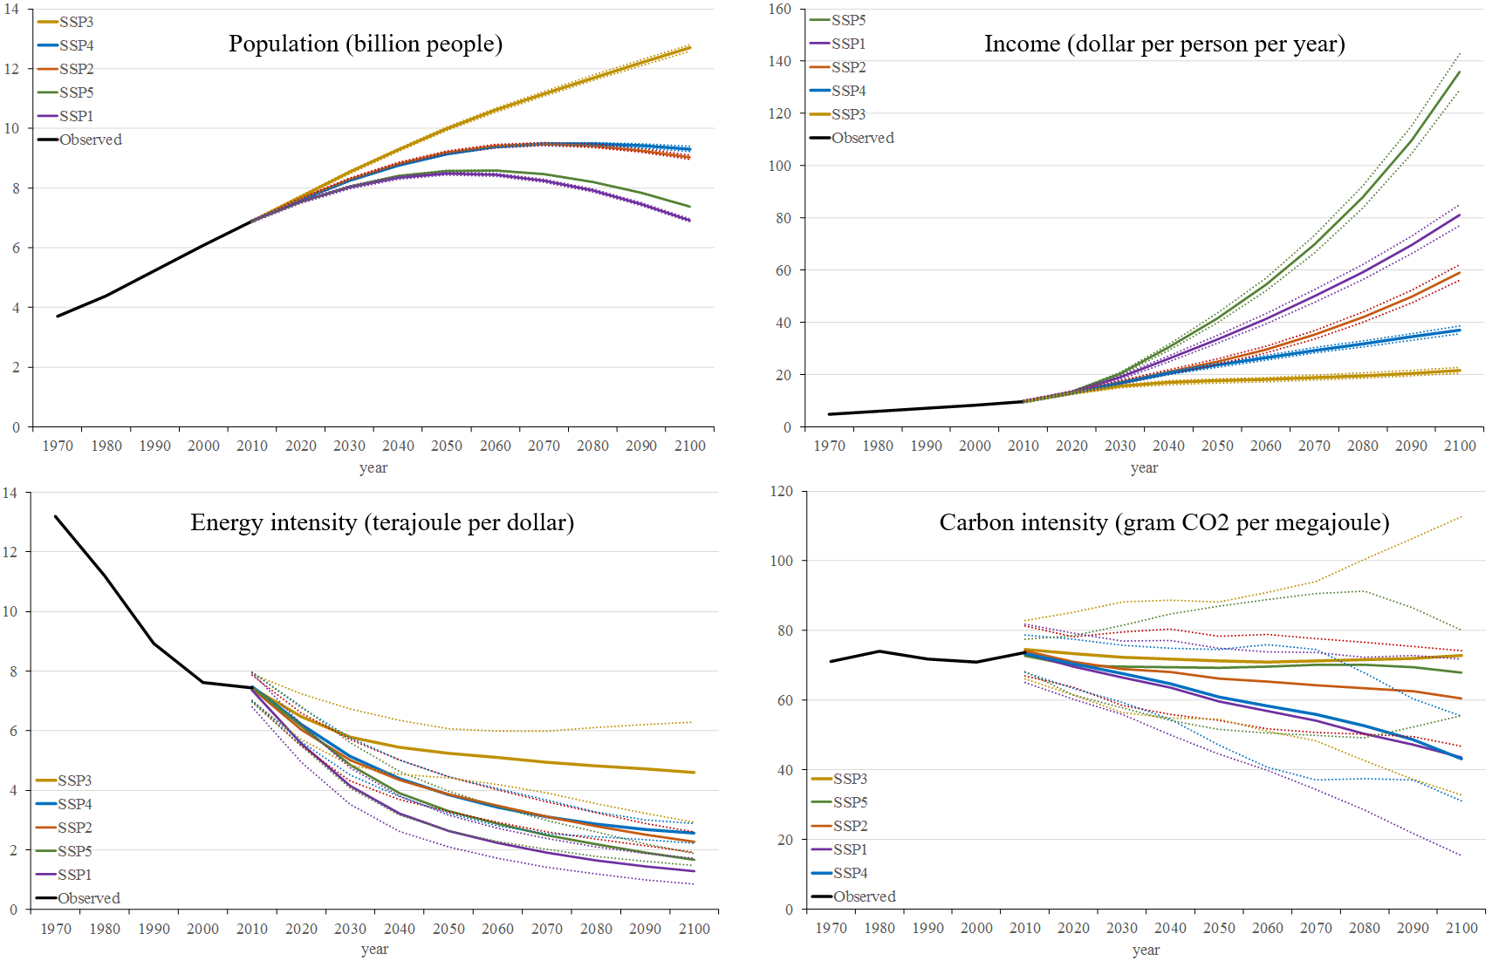

Slide 14

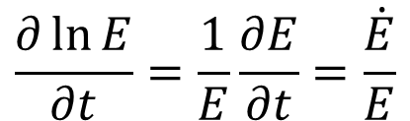
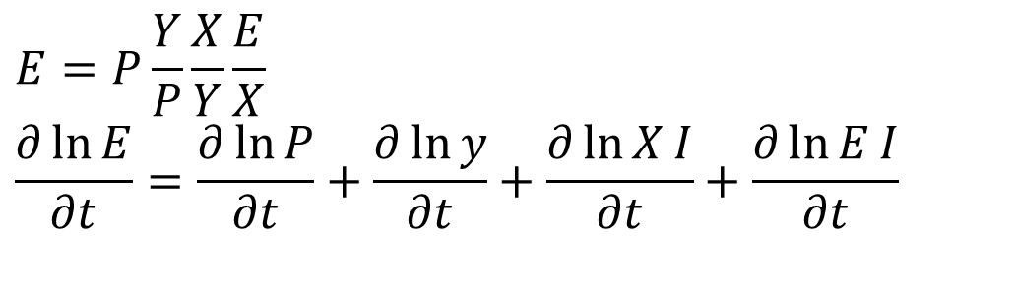
How to abate emissions?
Kaya identity
To reduce emissions, one can
Reduce population growth
Reduce economic growth
Save energy
Switch to different energy sources
$$E=P\frac{Y}{P}\frac{X}{Y}\frac{E}{X} \\ \frac{∂\ln{E}}{∂t}=\frac{∂\ln{P}}{∂t}+\frac{∂\ln{y}}{∂t}+\frac{∂\ln{X}I}{∂t}+\frac{∂\ln{E}I}{∂t}$$
$$\frac{∂\ln{E}}{∂t}=\frac{1}{E}\frac{∂E}{∂t}=\frac{\dot{E}}{E}$$

Slide 15
Former USSR: Economy and emissions

Slide 16
Save Energy
Energy savings come through technological change and behavioural change
For a single product, new models tend to be more efficient, but the technological advance may be used to increase comfort
A lot of energy is wasted
Habits are hard to change
Principal/agent problems
The demand for energy services is even harder to change

Slide 17
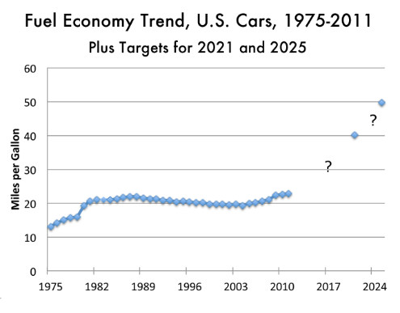
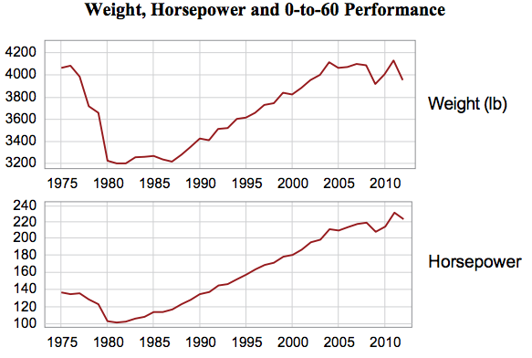

Slide 18
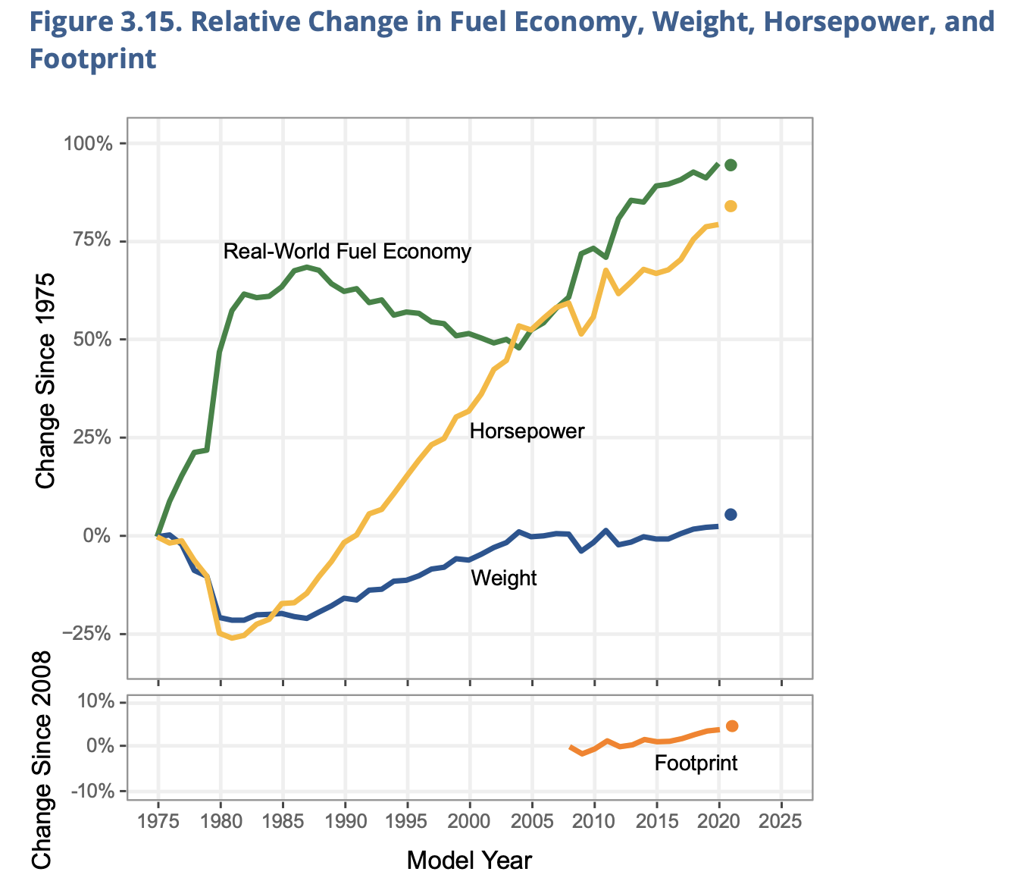

Slide 19
Save Energy
Energy savings come through technological change and behavioural change
For a single product, new models tend to be more efficient, but the technological advance may be used to increase comfort
A lot of energy is wasted
Habits are hard to change
Principal/agent problems
The demand for energy services is even harder to change

Slide 20
Switch Energy
Switching away from oil, gas and coal to nuclear, hydro, wind, solar and biomass is technically feasible
Nuclear and hydro are difficult politically and socially
Wind is expensive and visually intrusive
Solar is more expensive still, except in some niche markets
Both wind and solar require storage and transport
Biomass is too expensive, and bad for health, environment and food production

Slide 22
Switch Energy
Switching away from oil, gas and coal to nuclear, hydro, wind, solar and biomass is technically feasible
Nuclear and hydro are difficult politically and socially
Wind is expensive and visually intrusive
Solar is expensive and has a waste problem
Both wind and solar require storage and transport
Biomass is too expensive, and bad for health, environment and food production

Slide 23
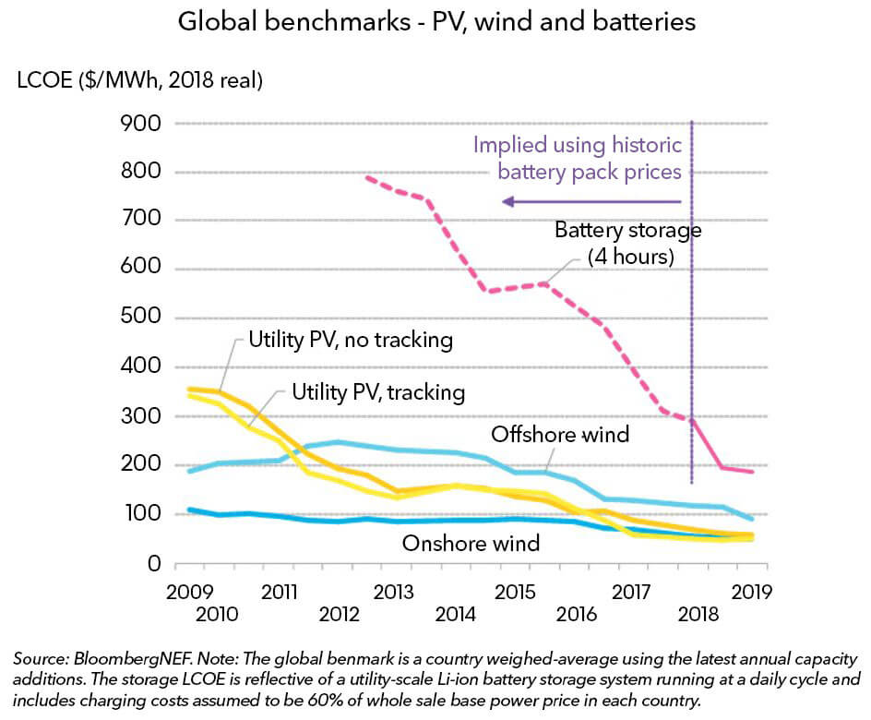

Slide 24
Switch Energy
Switching away from oil, gas and coal to nuclear, hydro, wind, solar and biomass is technically feasible
Nuclear and hydro are difficult politically and socially
Wind is expensive and visually intrusive
Solar is expensive and has a waste problem
Both wind and solar require storage and transport
Biomass is too expensive, and bad for health, environment and food production

Slide 25
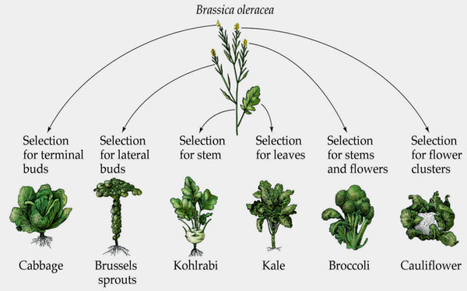

Slide 26
Switch Energy
Switching away from oil, gas and coal to nuclear, hydro, wind, solar and biomass is technically feasible
Nuclear and hydro are difficult politically and socially
Wind is expensive and visually intrusive
Solar is expensive and has a waste problem
Both wind and solar require storage and transport
Biomass is too expensive, and bad for health, environment and food production

Slide 27
Carbon Sinks
As deforestation is a source of carbon dioxide emissions, afforestation is a sink
Note that the forests of North America and Europe are growing back
If slowing deforestation in the tropics were easy, it would have been done for other reasons

Slide 28
Carbon Capture and Storage
Take the CO2 out of the exhaust gas, and stick it in the ground
Proven technology: soda, beer, greenhouses, and enhanced oil recovery
However, abatement requires purpose-build storage at a much larger scale
Retrofit expensive, so for new power stations only
Issues with efficiency, cost, safety
End-of-pipe technology

Slide 29
Geoengineering
Change the climate again
Dust in the atmosphere
Mirrors in space
Great uncertainty
Previous experiments went wrong (quite so)
Nonetheless, most of this is cheap and simple
Unclear who will/should decide on geoengineering

Slide 30
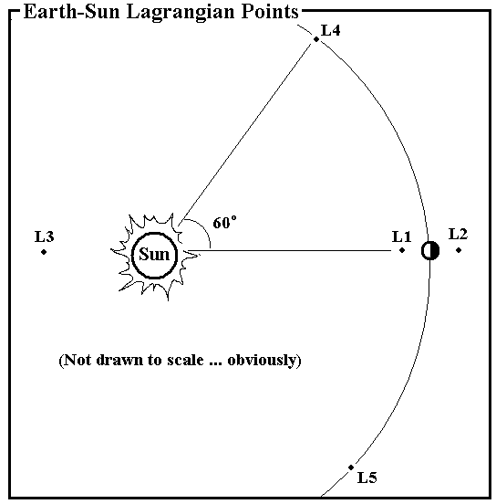

Slide 31
Geoengineering
Change the climate again
Dust in the atmosphere
Mirrors in space
Great uncertainty
Previous experiments went wrong (quite so)
Nonetheless, most of this is cheap and simple
Unclear who will/should decide on geoengineering

